Slide 1
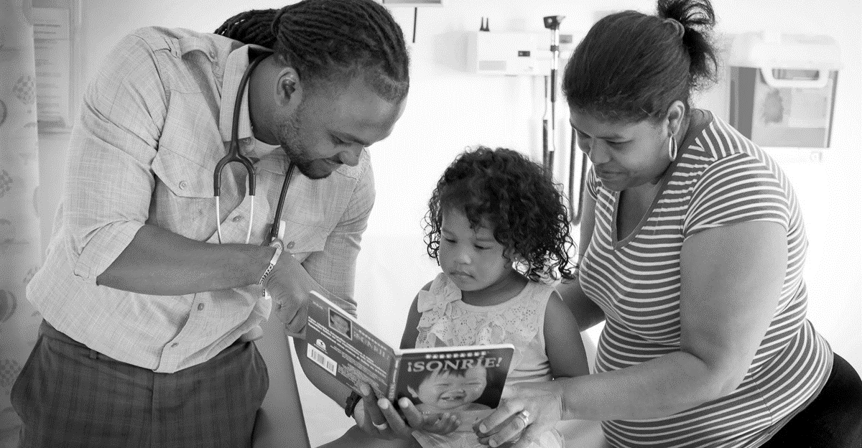

Reach Out & Read IL – Staff Refresher

Slide 2
This staff refresher is NOT a substitute for the myROR.org training
& is NOT CME accredited.
Notes:
This refresher course is not a replacement or substitute for the core training provided in your myROR.org portal. If you still need to complete your core training, please let me know. This MUST be completed prior to implementation of the Reach Out & Read program during well-child visits.

Slide 3
Our Clinic’s Reach Out & Read Contacts
Insert an image of your clinic’s ROR team
Primary Contact / On site Coordinator:
  NAME
Medical Champion:
  NAME
Additional ROR Contacts:
  NAME
Notes:
Here at SITE NAME, PRIMARY CONTACT/ON-SITE COORDINATOR and MEDICAL CONSULTANT work directly with Reach Out & Read Illinois to actively champion the Reach Out & Read program here in our clinic. This includes completing yearly site visits, ensuring the fidelity of the Reach Out & Read model, and collaborating to meet the needs of our patients and their families.

Slide 4
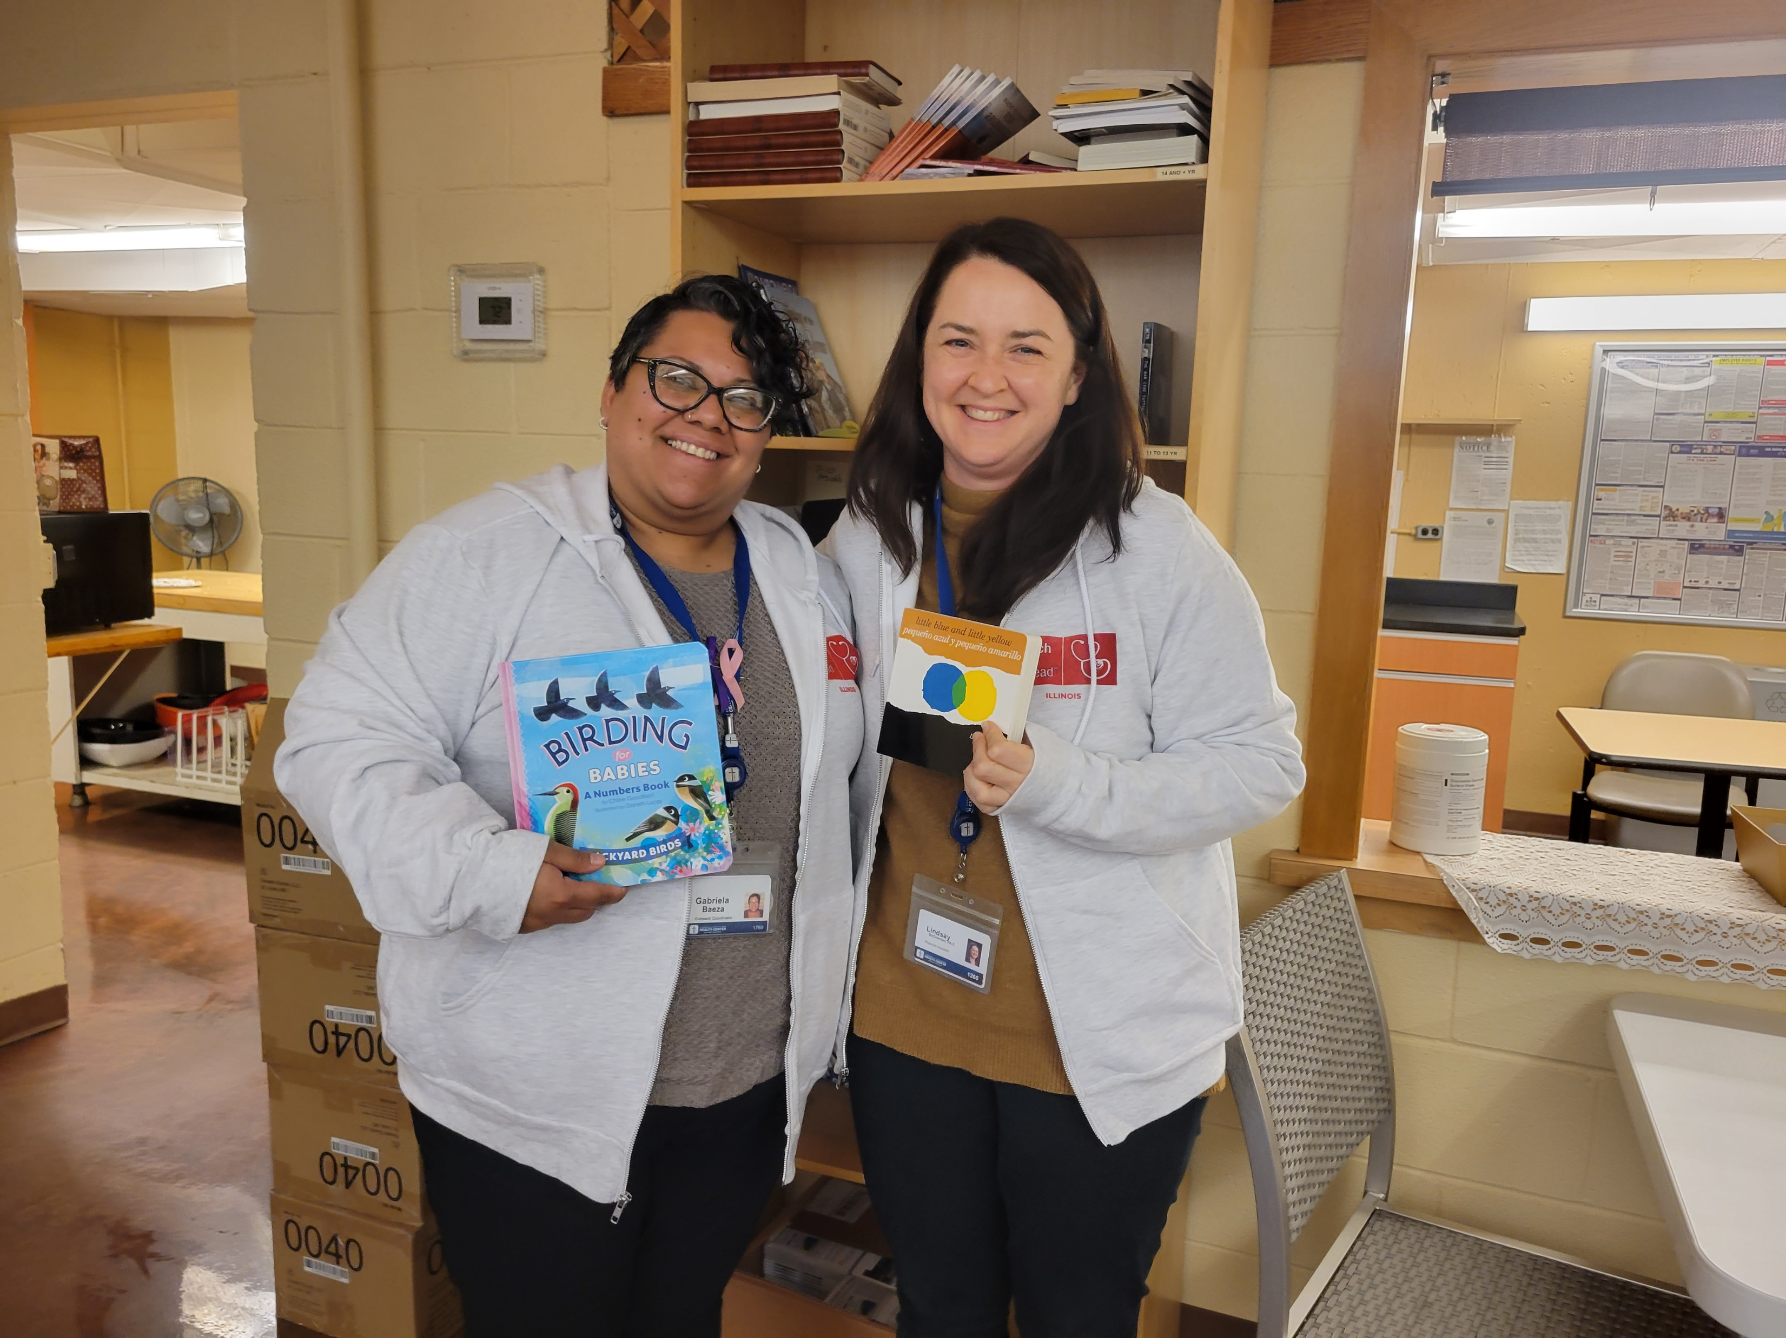
Agenda
Reach Out & Read’s Mission
The Reach Out & Read Model
  A Look at a Reach Out & Read Guided Patient Visit
  Backed by Evidence
  Benefits of the Reach Out & Read Program
Role of the Book
  Selecting a Book
  Using the Book
  Literacy Rich Environments
myROR Staff Training

Slide 5
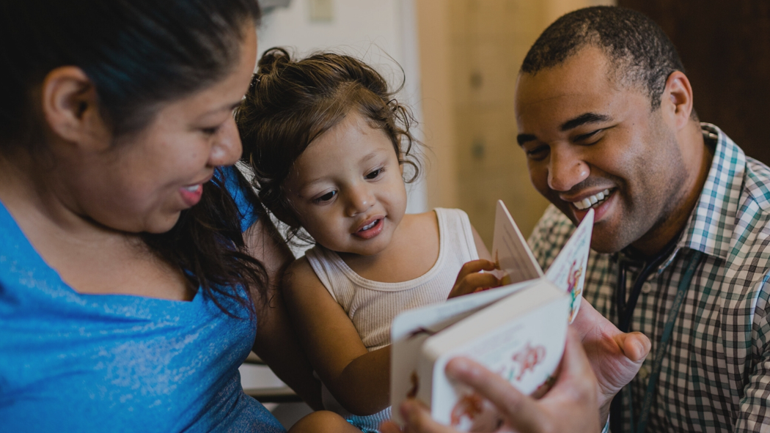
The Reach Out and Read Model

Slide 6
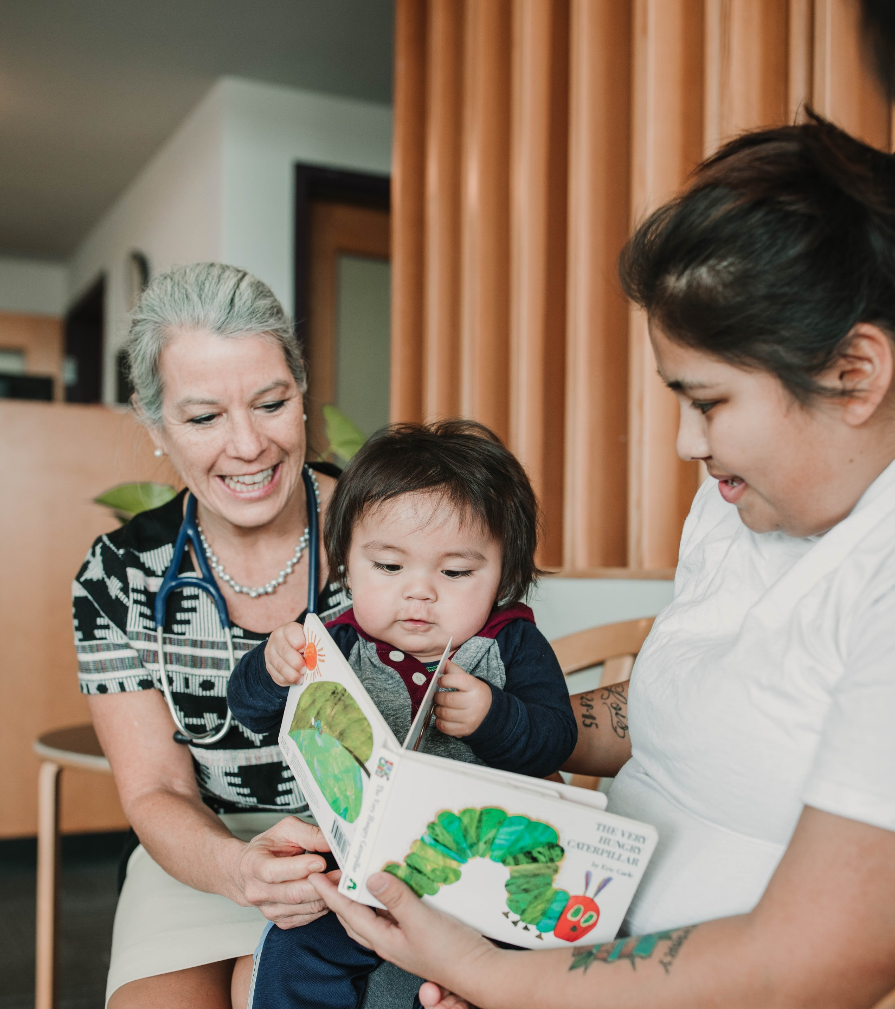
Reach Out & Read’s Mission
Reach Out & Read is a nonprofit organization that works to give young children a foundation for success by incorporating books into pediatric care and encouraging families to read together.
This process:
Improves child literacy
Improves familial relationships
Improves the relationship between provider and child
Reach Out & Read is the only early literacy program to be endorsed by the American Academy of Pediatrics (AAP).
Notes:
The program is implemented during pediatric visits. Providers facilitate well-child visits by engaging families with children’s books. During the visit, the provider observes how the child interacts with the book and encourages the caregiver to also engage by reading with and to the child.

Slide 7
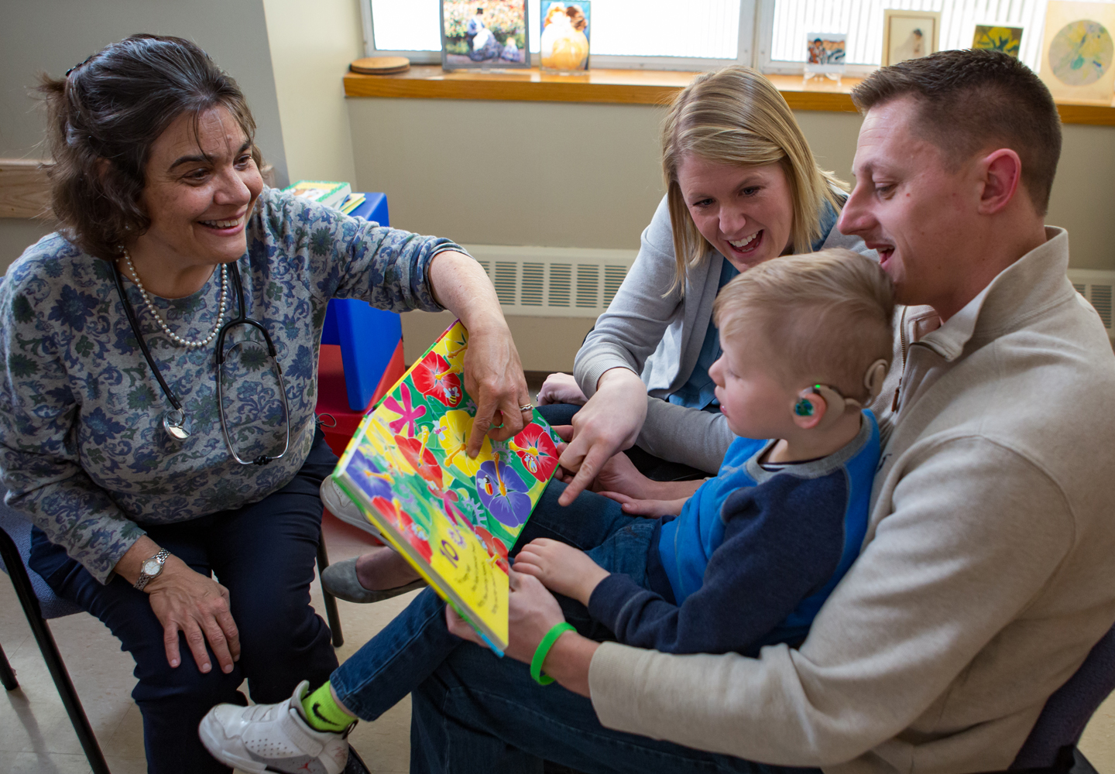
The ROR Model
At routine health check-ups from infancy through 5 years,
Reach Out & Read-trained doctors and nurse practitioners:
talk with parents about the benefits of reading aloud and engaging with their young children
encourage them to cuddle up, read together at home, and build routines around books
show them how to look at books and talk about the stories with their infants, toddlers, and preschoolers
and give the child a new book to take home and keep
During the exam, providers also use the book for developmental surveillance, observing how the child and caregiver interact with the book and each other
Notes:
The Reach Out & Read model of literacy promotion and family engagement consists of three key elements:
Offering anticipatory guidance: Primary care providers (Doctors, NPs, and PAs) are trained to deliver anticipatory literacy guidance to parents and caregivers of children from infancy through 5 years of age during each well-child visit. This age-appropriate guidance centers on the importance of elements such as frequent and early exposure to language, looking at board books and naming pictures with infants, rhyme, and repetition for gaining phonemic awareness during toddlerhood, and reading interactively (such as asking open-ended questions) when reading with preschoolers. Providers also use this opportunity to model reading aloud and introduce it as another way to support positive interactions between caregiver and child.
Building children’s at-home libraries -- Additionally, the provider introduces a new, developmentally appropriate book into the visit for the child to take home, building a child’s collection of 8-10 new books before kindergarten. Books are given at least from the 6-month visit, but also earlier visits, if possible.
Creating literacy-rich environments -- Reach Out & Read sites also create literacy-rich environments that may include gently used books for waiting room use or for siblings to take home. In some waiting rooms, Reach Out & Read volunteers model for parents the pleasures and techniques of reading aloud with very young children.

Slide 8
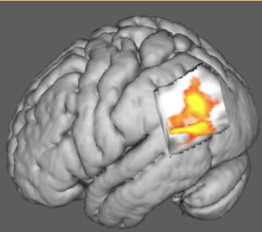
What is the Evidence?
Built on and backed by science
Supported by more than 20 independent, peer-reviewed research
Endorsed by the American Academy of Pediatrics and supported by the American Academy of Family Physicians
Reading aloud is important for healthy brain development.
Notes:
Connect families to literacy supports young
Relative low cost to clinics
Peer reviewed studies show:
Improved child language development
Improved clinic morale
Improved clinic and family relationship

Slide 9

What are the Benefits?
Build relationships with families
Kids are more excited to come to well visits
Well-child visit attendance improves
Clinic morale improves
Child language development improves
Children get quality books to take home

Slide 10
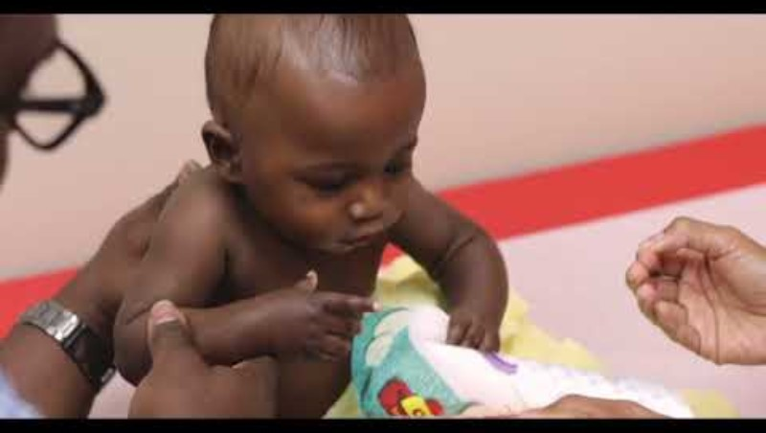
Reach Out & Read –
What it Looks Like
Notes:
Share video - https://www.youtube.com/watch?v=4pyf4j_7_Bs&ab_channel=ReachOutandRead

Slide 11
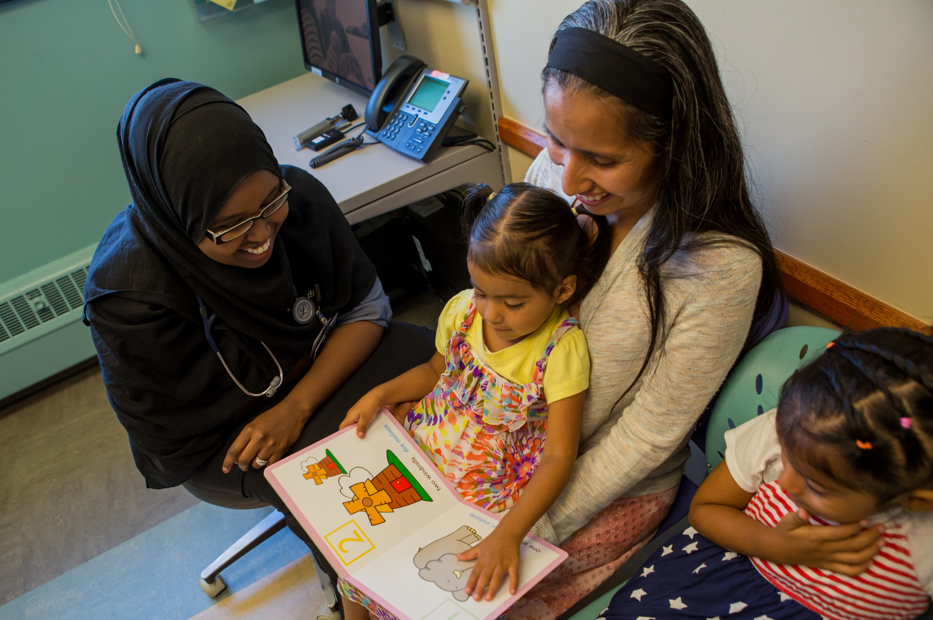
The Role of the Book in the Exam Room

Slide 12
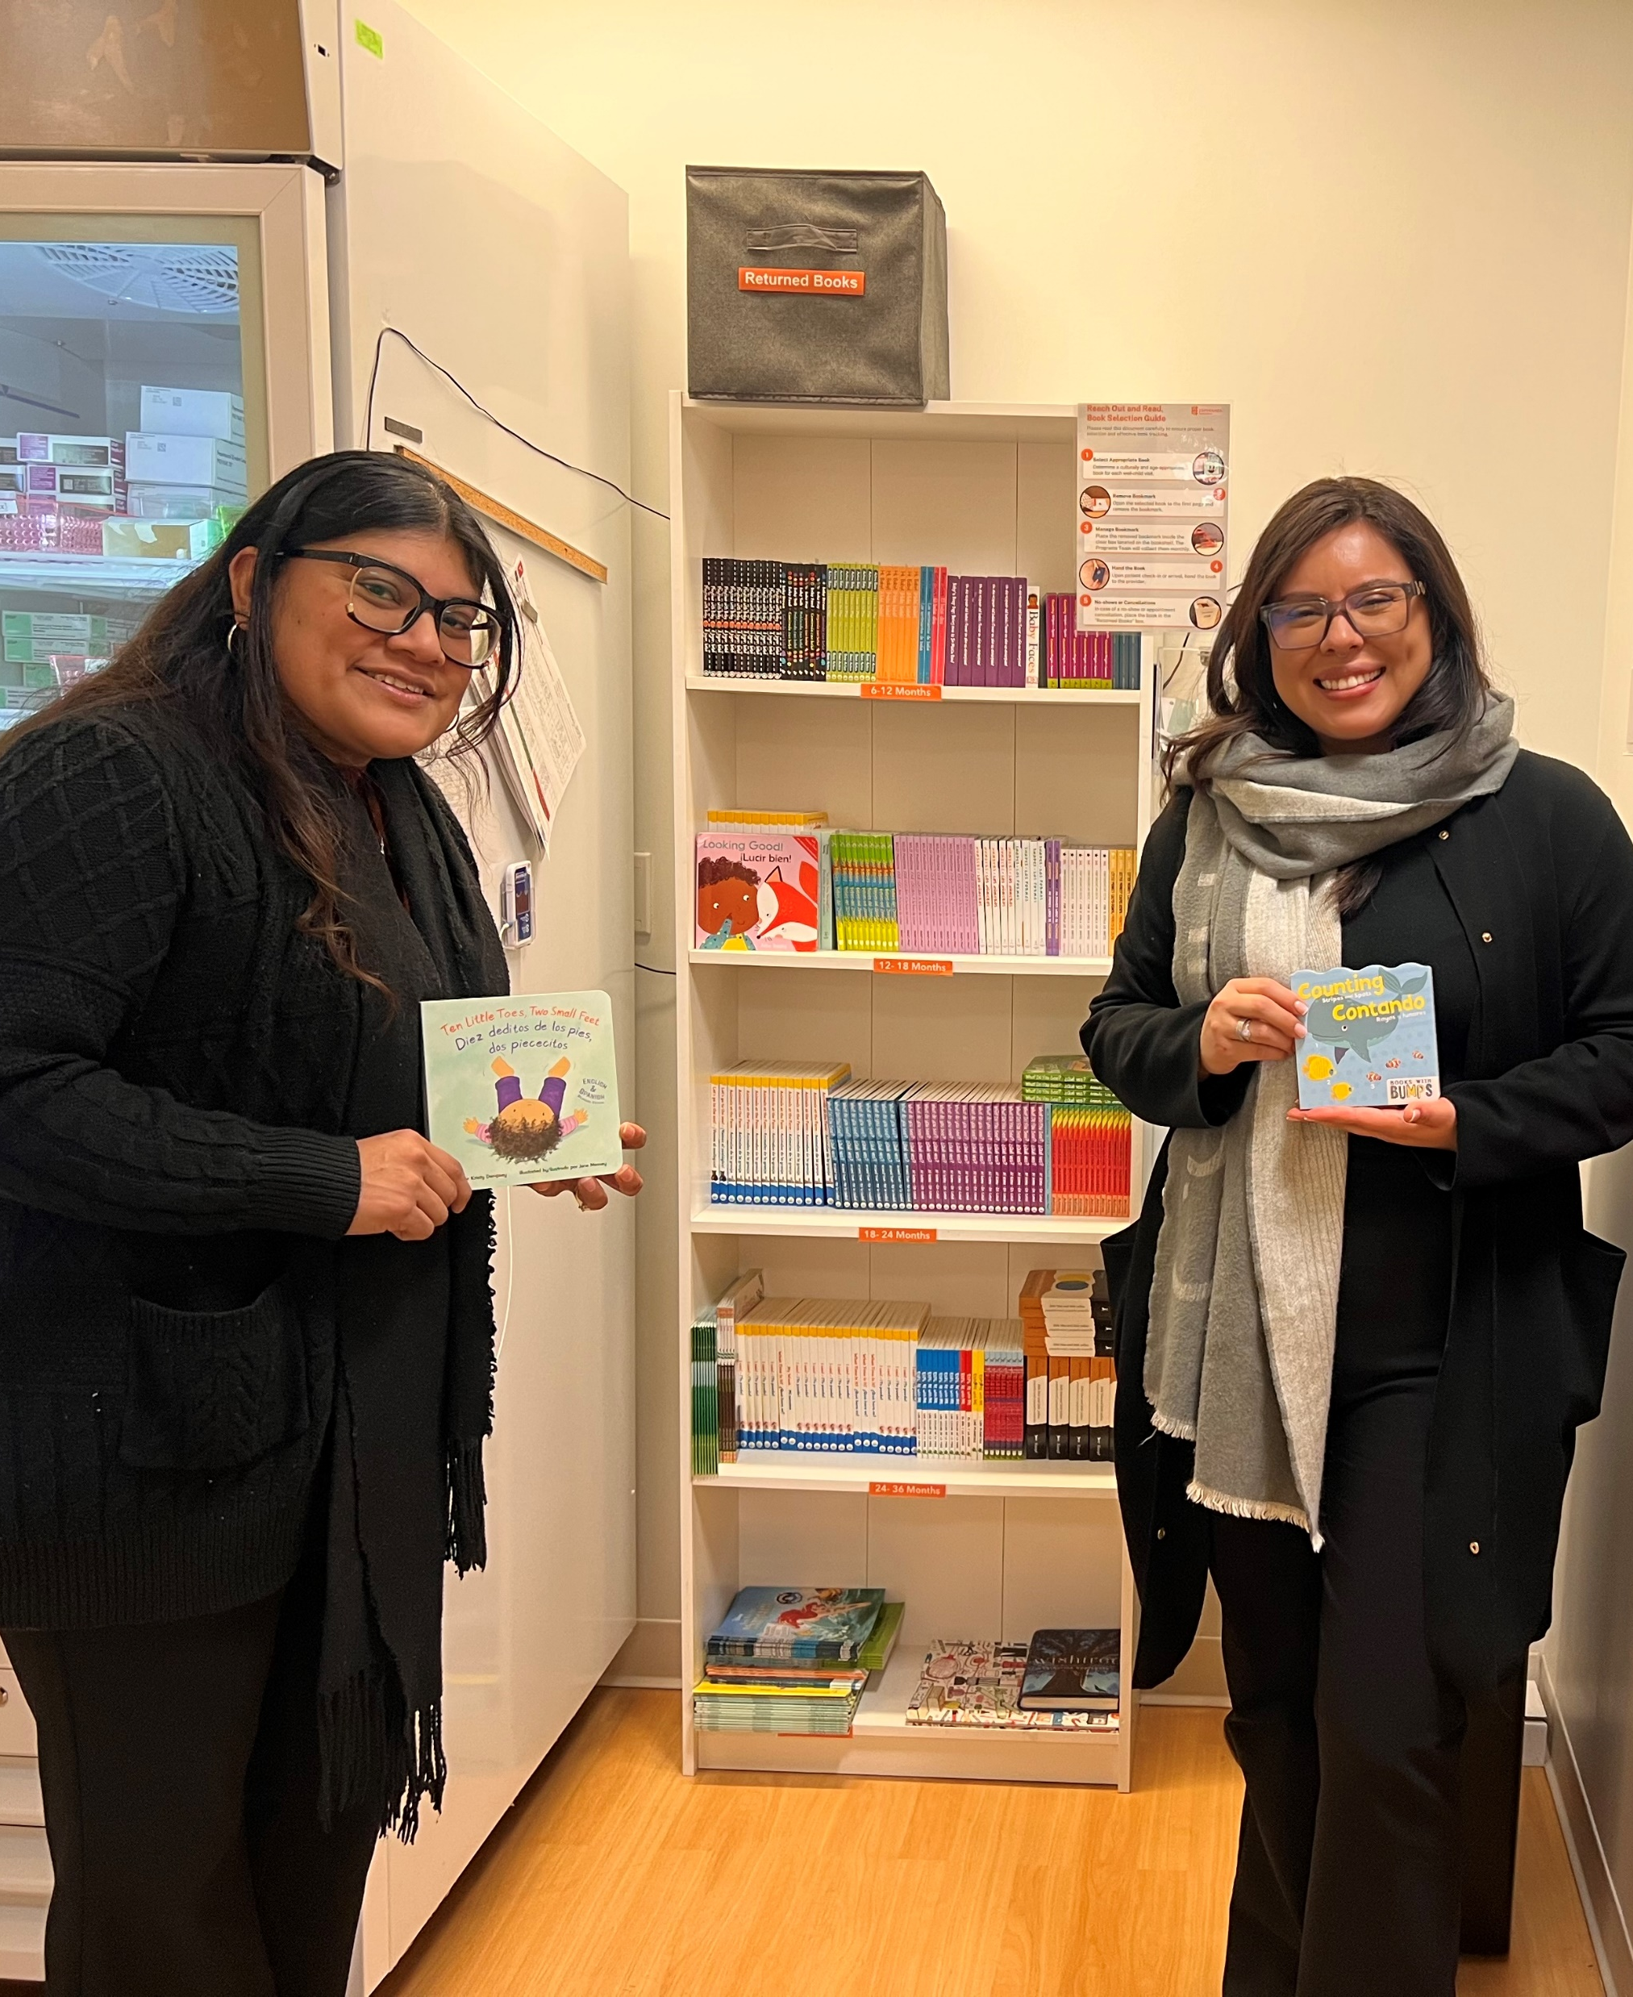
Selecting a Book
Developmentally appropriate
  Board books, paperback picture books, hardcover picture books
  High contrast images
  Text or image heavy books
Culturally relevant
Meet linguistic needs
Notes:
Choose books that are appropriate for your patient population and community. Take care to provide a book that reflects the parent’s or caregiver’s preferred language and comfort with reading. Wordless books and books in languages other than English should also be made available. These books should also be developmentally appropriate so that the child can be encouraged to engage with the book. Consider the child’s age when selecting the type of book (board book, paperback vs. hardcover picture book), the contrast of the images, and how much text is on each page of the book.
Books at a significant discount are available through the Reach Out & Read All About Books and Scholastic Catalogs, which offer recommended titles for use by Reach Out & Read sites.
Reach Out & Read books are selected for literary quality and intended to be free of gender and cultural stereotypes as well as commercial bias. We strive to find books that reflect and showcase the diverse community of families we serve, and which will allow children to see positive reflections of their own families. You should take care to select books that are appropriate for your families’ needs

Slide 13
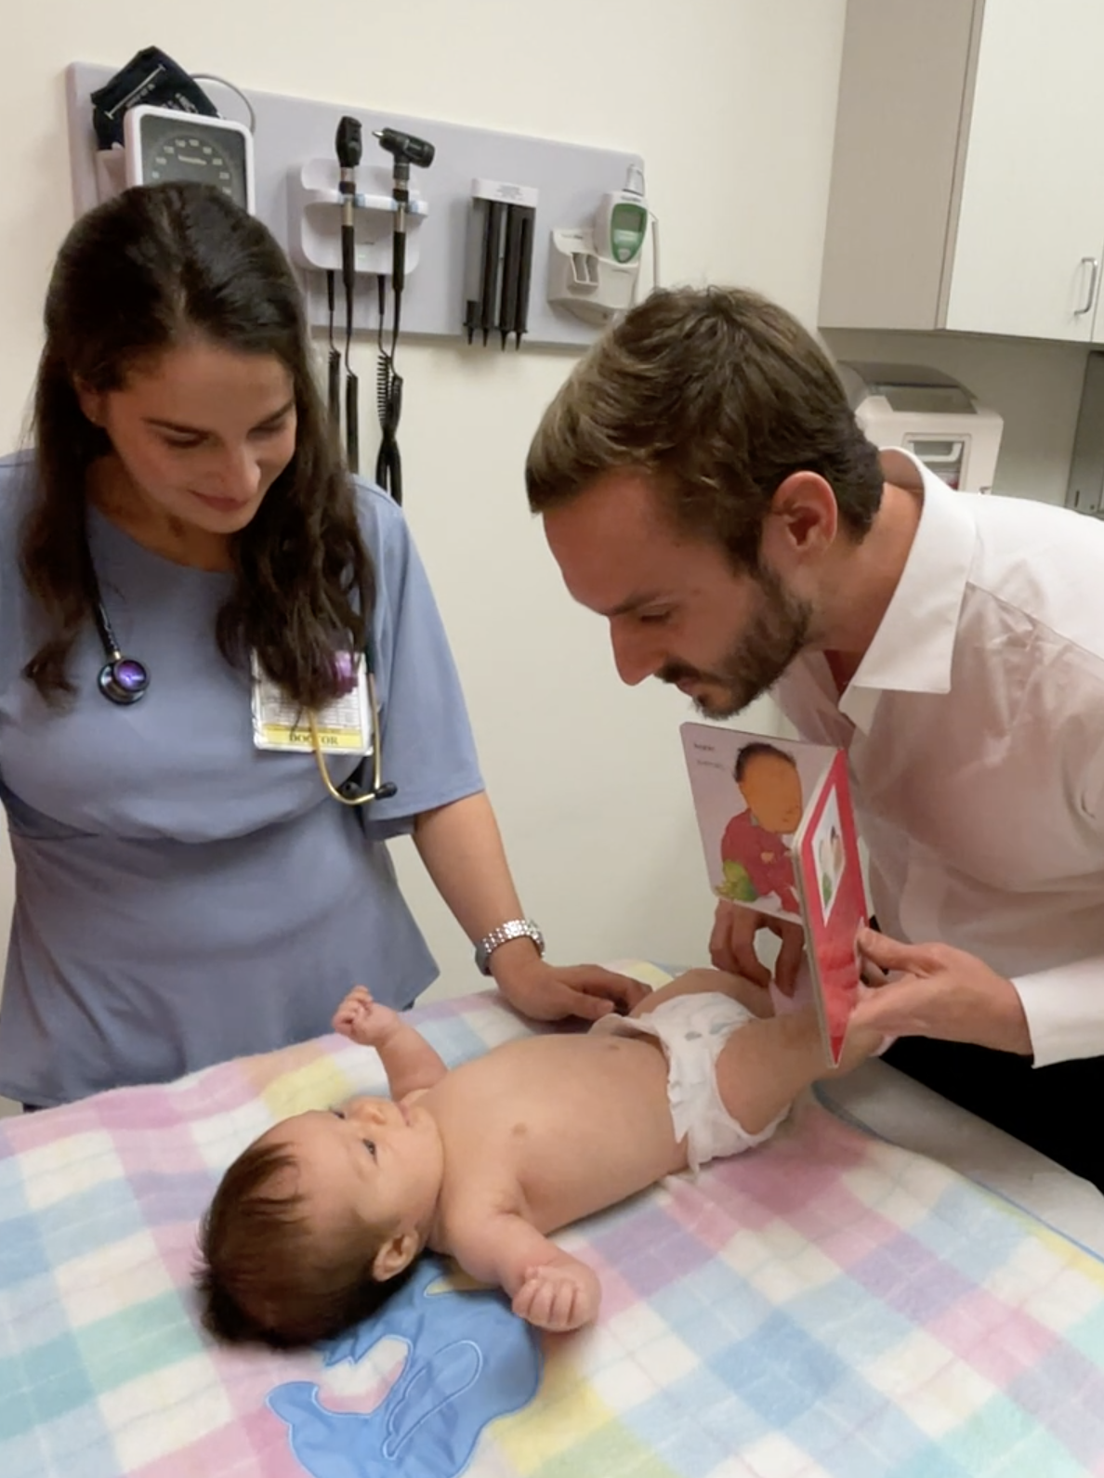
Using the Book: Anticipatory Guidance and Modeling
Books should not be handed at the completion of the well-child visit
Use the book as a tool to guide the visit
Encourage caregivers in their efforts outside of the visit
Inform caregivers of upcoming developmental milestones/things to be on the lookout for
Notes:
Discuss with parents and caregivers how important it is to talk, sing, read, and play with children starting at birth; positive, responsive interactions in the early days, months, and years foster the development of strong nurturing relationships that are the foundation for healthy early childhood development.
Describe and model prototypical conversations using “serve and return” interactions, interactive (dialogic) reading, and other developmentally appropriate techniques for enjoying books with young children.
Using the Developmental Milestones of Early Literacy, help parents and caregivers appreciate the literacy and language skills their children are developing, focusing both on current skills and on the next developmental stages.
Ask about reading activities in the home and offer positive reinforcement; be sensitive to parents and caregivers with limitations or concerns regarding their own language or literacy skills, and offer support and encouragement for a variety of strategies for enjoying books together with children.
Talk with parents and caregivers about the benefits of looking at books and/or reading together with children; how this can contribute to a child’s love of books; and how experience with books promotes school readiness.
Discuss with parents and caregivers how they can integrate reading aloud into a young child’s daily routine. Reference and include the book in discussions of transitions, bedtime routines, sleep, school readiness, as well as other appropriate aspects of primary care.

Slide 14

Literacy-Rich Environment
The literacy message should extend beyond the book
Ideally, waiting and exam rooms contribute to a literacy rich environment
Consider:
  Creating displays about books, reading, family literacy, and/or the local library
  Provide gently used books for families to read together while waiting for their visit and, when possible, to take home when they leave
  Involve volunteers in your waiting room, where they can read and model dialogic reading and read-aloud techniques
Notes:
The literacy message extends throughout the clinic, creating a literacy-rich environment. Where possible:
Create displays about books, reading, family literacy, and the local library
Provide gently-used children’s books for the family to read together while waiting for their visit and to take home when they leave
Have volunteers read to children and parents/caregivers in the waiting room, modeling dialogic reading and read-aloud techniques, and showing parents and caregivers how much children enjoy reading aloud
Provide information about community supports such as library/storytime, early intervention resources, headstart/preschool information

Slide 15
myROR.org Training

Slide 16
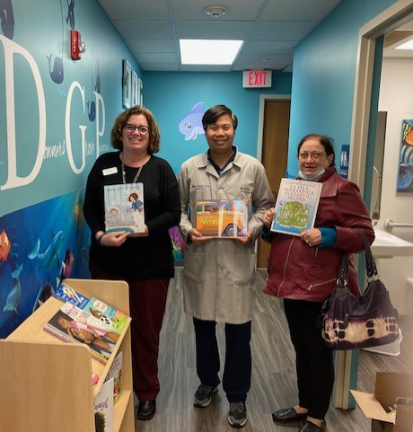
The myROR.org training is an online CME-accredited training that must be completed before a provider can begin implementing the ROR program into their well-child visits
Anyone who is aiding with well-child visits for patients ages birth to five-year-old should complete this required training
Let your ROR on-site coordinator know if you haven’t completed this training!
Notes:
The Reach Out & Read core training is a self-paced (approximately ninety minutes) online course designed to prepare pediatric primary care clinicians to implement Reach Out & Read during well-child visits from infancy through age five. The training provides practical, concrete, and tested strategies for providers to discuss the importance of talking, singing, and reading aloud from birth with the parents of their patients.
All participating Reach Out and Read providers must complete the Reach Out and Read training before they begin implementing the program. The training saves your progress as you go, allowing you to complete it in more than one sitting. Our goal as a clinic is to have a 75% minimum training rate.
The online training course is accredited and offers:
• 1.5 CME credits from the AAFP to participating MDs, DOs, NPs, and PA-Cs; credits may also be available to other eligible medical providers
• 1.0 MOC Part 2 points for participating pediatricians who pass the training with a score of 70% or higher

Slide 17
Why Complete the myROR.org Training?
Reach Out & Read is a national program and, by completing this foundational training, you ensure that the core mission of ROR is carried out successfully and effectively.
Contact the ROR IL team if you have any issues accessing your training or your myROR.org account.
Notes:
After completing the training, you will be able to:
Recognize the importance of integrating early literacy promotion into pediatric primary healthcare visits
Highlight for caregivers the importance of talking, singing, and reading aloud from birth in healthy early childhood development
Incorporate books and early literacy guidance and modeling into pediatric primary care in an age-appropriate way that promotes warm, responsive, caregiver-child interactions
Use books in the exam room to enhance developmental surveillance in accordance with the Bright Futures guidelines
Use literacy promotion within the well-child visit to provide anticipatory guidance about development and language, stimulation, interaction, limiting screen time, building daily routines and bedtime rituals, and school readiness
Promote the importance of both reading aloud and print-rich environments to the acquisition of foundational literacy skills during the earliest years of life
Support caregivers in finding those everyday moments of connection with their infants, toddlers, and preschoolers that we know provide the foundation for early childhood development and long-term health and well-being

Slide 18
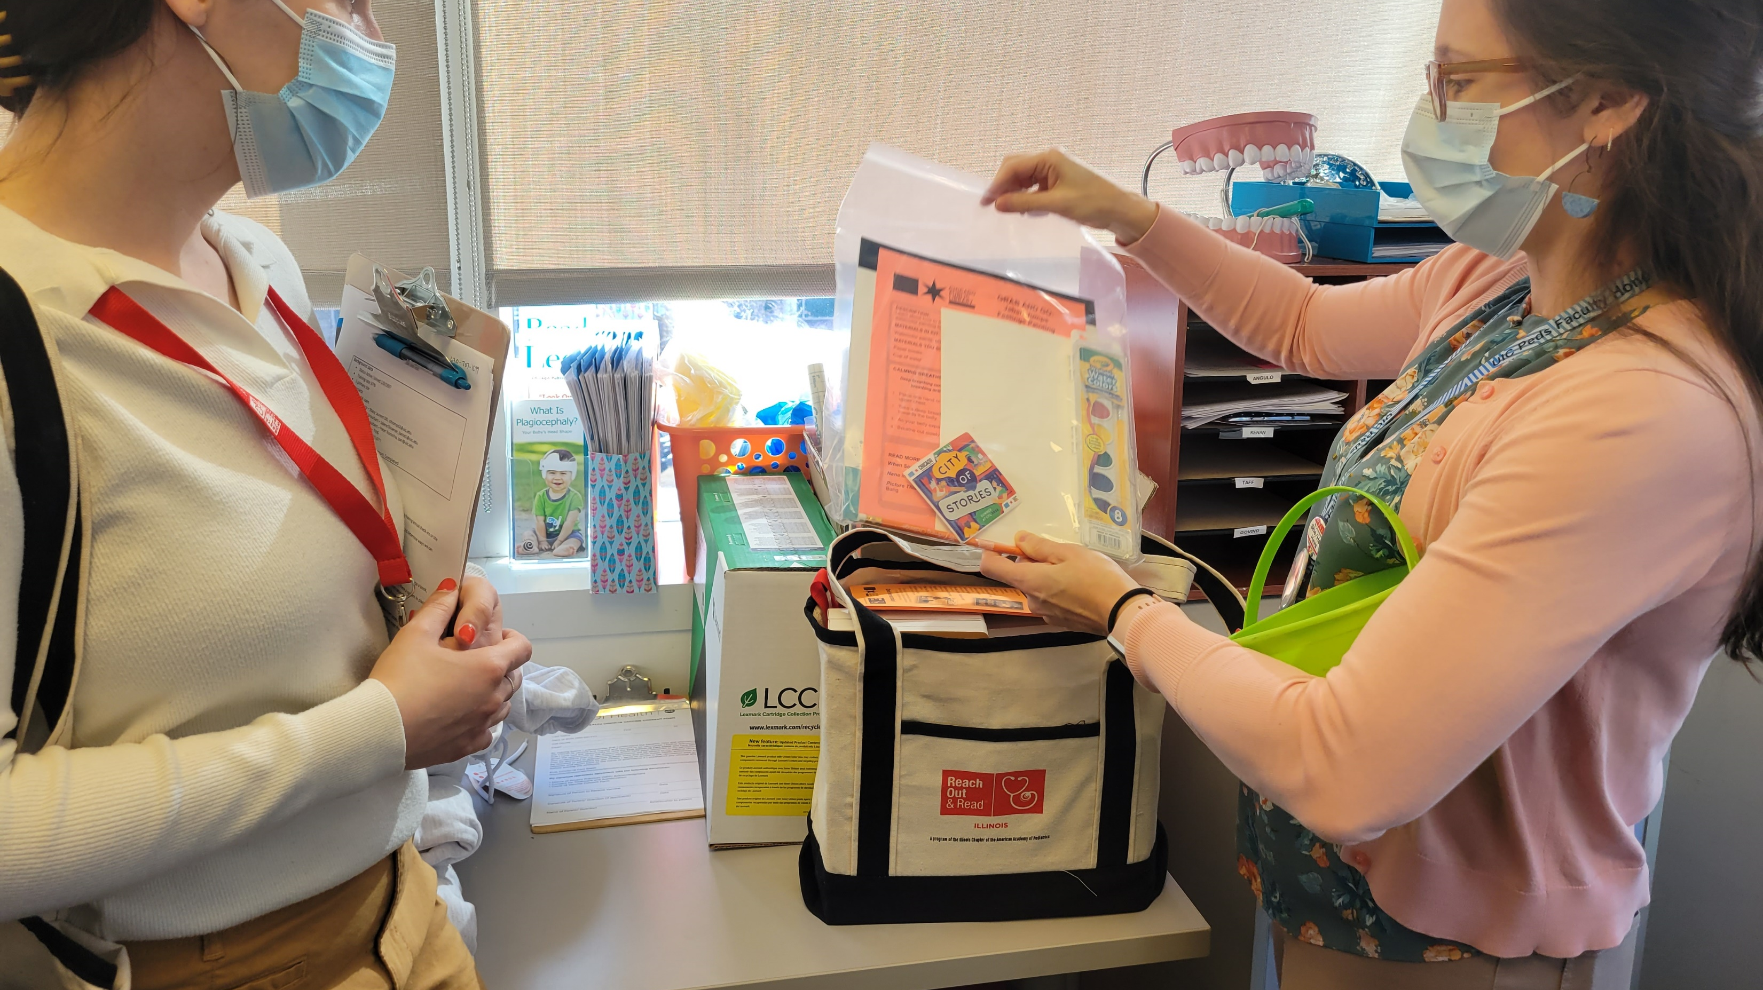
Questions?

Slide 19
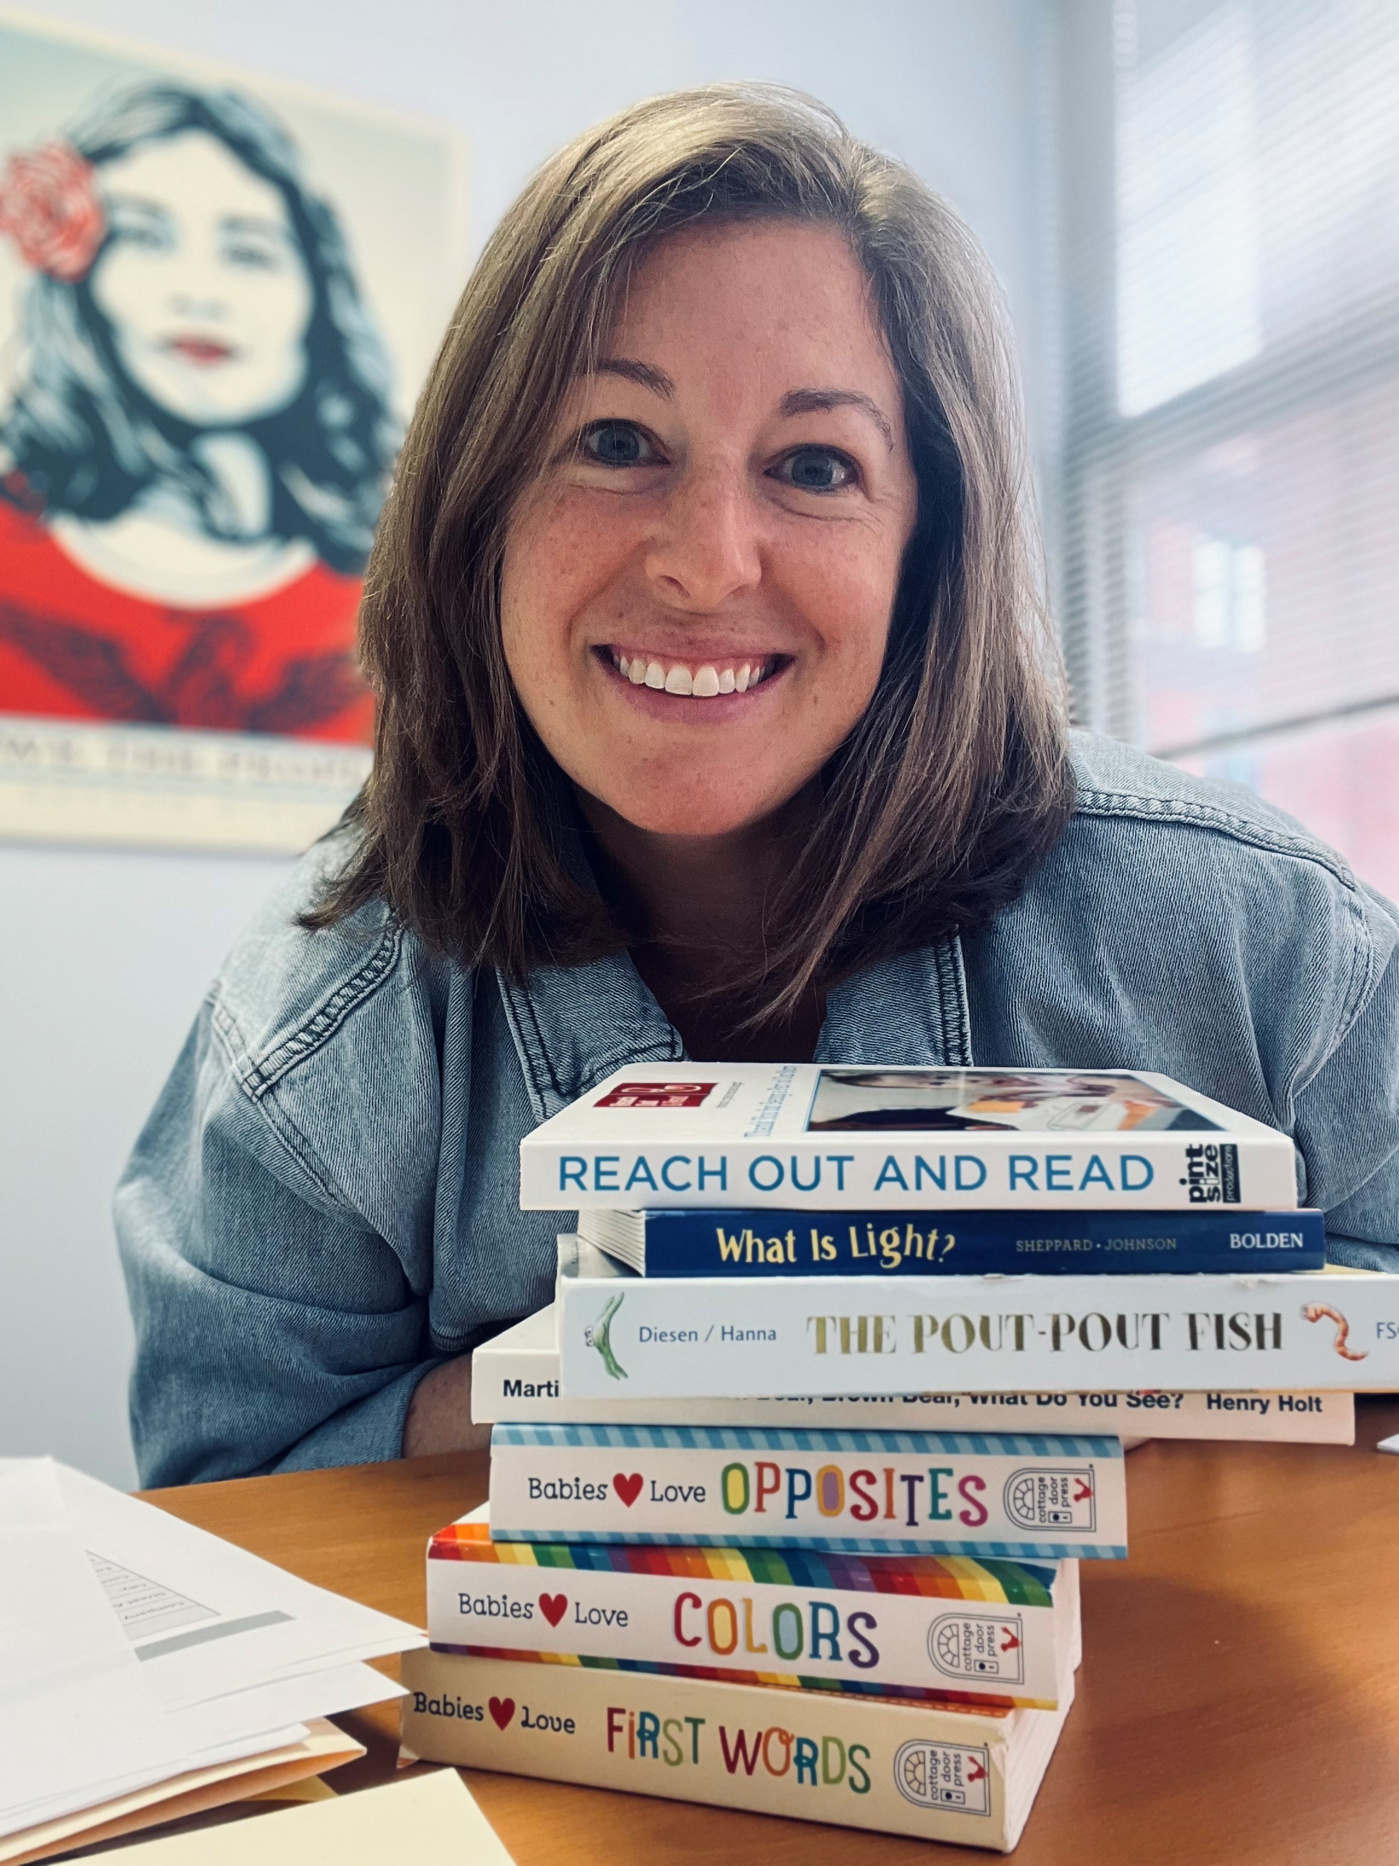

Contact the ROR IL Team
Cindy Ogrin
Chief Strategy Officer
cogrin@illinoisaap.com
Olivia Heinzeroth
Program Manager
oheinzeroth@illinoisaap.com

Slide 21
Title
Text
Text
Text
Notes:
After completing the training, you will be able to:
Recognize the importance of integrating early literacy promotion into pediatric primary healthcare visits
Highlight for caregivers the importance of talking, singing, and reading aloud from birth in healthy early childhood development
Incorporate books and early literacy guidance and modeling into pediatric primary care in an age-appropriate way that promotes warm, responsive, caregiver-child interactions
Use books in the exam room to enhance developmental surveillance in accordance with the Bright Futures guidelines
Use literacy promotion within the well-child visit to provide anticipatory guidance about development and language, stimulation, interaction, limiting screen time, building daily routines and bedtime rituals, and school readiness
Promote the importance of both reading aloud and print-rich environments to the acquisition of foundational literacy skills during the earliest years of life
Support caregivers in finding those everyday moments of connection with their infants, toddlers, and preschoolers that we know provide the foundation for early childhood development and long-term health and well-being

Slide 22
Title
Text
Text
Text
Notes:
After completing the training you will be able to:
Recognize the importance of integrating early literacy promotion into pediatric primary healthcare visits
Highlight for caregivers the importance of talking, singing, and reading aloud from birth in healthy early childhood development
Incorporate books and early literacy guidance and modeling into pediatric primary care in an age-appropriate way that promotes warm, responsive, caregiver-child interactions
Use books in the exam room to enhance developmental surveillance in accordance with the Bright Futures guidelines
Use literacy promotion within the well-child visit to provide anticipatory guidance about development and language, stimulation, interaction, limiting screen time, building daily routines and bedtime rituals, and school readiness
Promote the importance of both reading aloud and print-rich environments to the acquisition of foundational literacy skills during the earliest years of life
Support caregivers in finding those everyday moments of connection with their infants, toddlers, and preschoolers that we know provide the foundation for early childhood development and long-term health and well-being

